Slide 1

FINAL PROJECT 1
- SauceDemo (CSD) -
- Muhammad Azwar Anas -

Slide 2

Create DEFECT REPORTING
BugS report
HOMEPAGE: Compatibility
Defect ID | Defect Title | User Story | Defect Description | Priority | Saverity | Pre-Condition | Replication Step | Expected Result | Actual Result
DF-01 | HP-004 | The Images do not Match | CSD-7 As a buyer, I want to be able to open the homepage and see the list of offered products | problem_user In Homepage has been created the image don't match | High | Minor | - Users are in the login page - User create login page with 3 components: Username text field, Password text field, and login text field - Create homepage showcasing all the offered products - User are able to see the homepage with all the image products distortion | 1. User simulate using mobile device with dimension (360x800) 2. User open Web application chrome 3. type the link https://www.saucedemo.com/ 4. Enter the username: problem_user 5. Enter the Password: secre_sauce 6. Click The button Login 7. Verify user in the homepage | PROBLEM_USER Displayed the homepage with all the image producst successfully | PROBLEM_USER: Displayed the homepage with all the image products mismatch

Slide 3
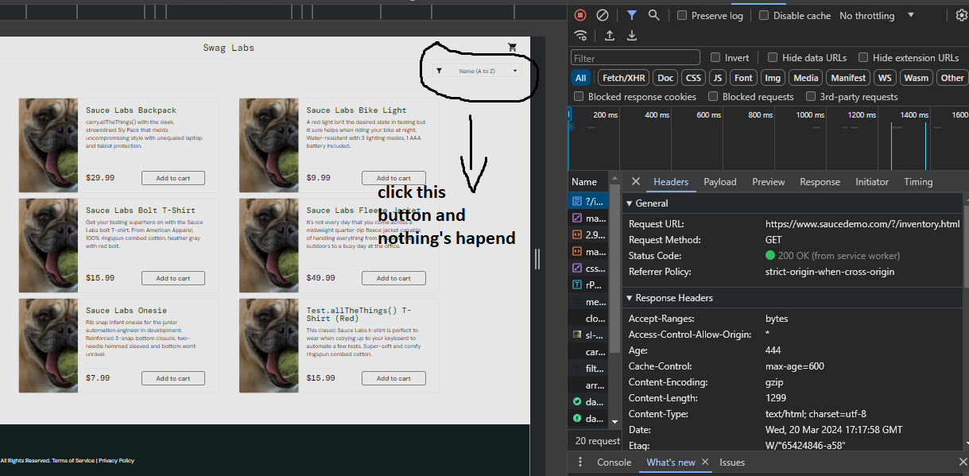
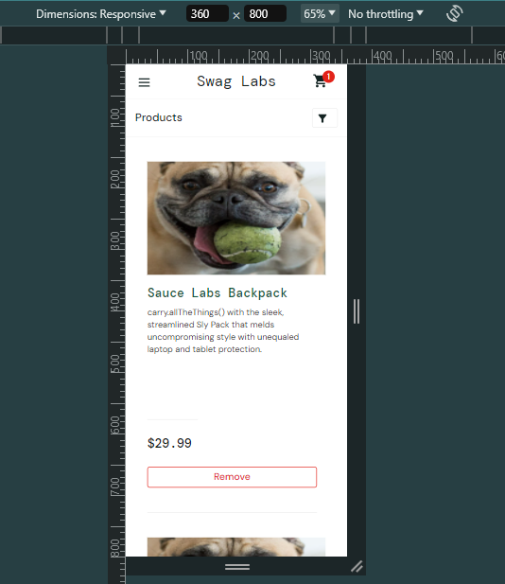
Create DEFECT REPORTING
BugS report
HOMEPAGE – EVIDANCE: The Images do not Match
Compatibility testing – dimensi mobile (360x800)

Slide 4
Create DEFECT REPORTING
BugS report
HOMEPAGE: Componen Test
Defect ID | Defect Title | User Story | Defect Description | Priority | Saverity | Pre-Condition | Replication Step | Expected Result | Actual Result
DF-02 | HP-005 | Componen Button Remove EXCHANGE Add to Cart disactivated | CSD-7 As a buyer, I want to be able to open the homepage and see the list of offered products | Users are problem_user & error_user Click "Add to Cart" button, the label on the button changes to "Remove", However, when users click the button again, nothing happens. | Low | Low | - Users are in the login page - User create login page with 3 components: Username text field, Password text field, and login text field - Create homepage showcasing all the offered products - User are able to see the homepage with all the image products distortion - User access componen button | 1. User open Web application chrome 2. type the link https://www.saucedemo.com/ 3. Enter the username: problem_user and error_user 4. Enter the Password: secre_sauce 5. Click The button Login 6. User click button Add to cart 7. User click button Remove | PROBLEM_USER & ERROR_USER 1. can be able access componen button "Add to Cart" successfully 2. can be able access componen button "Remove" successfully | PROBLEM_USER & ERROR_USER 1. can be able access componen button "Add to Cart" successfully 2. cannot be able access componen button "Remove"

Slide 5
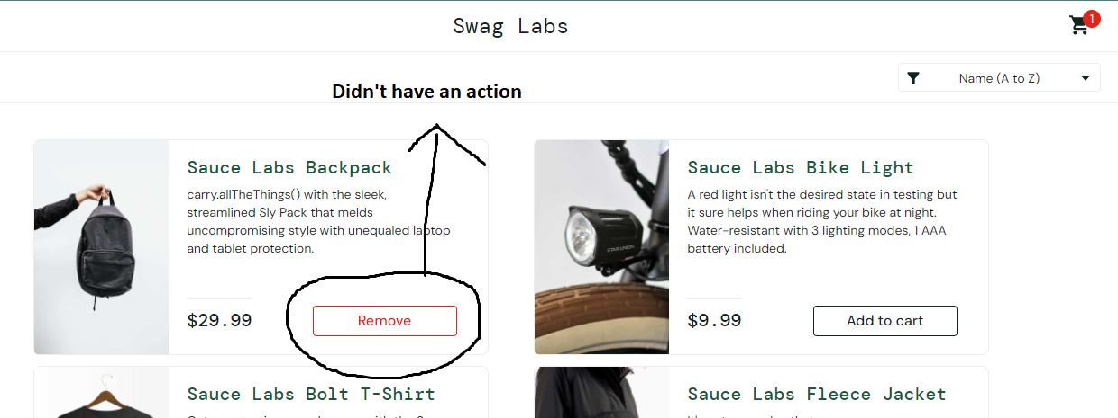
Create DEFECT REPORTING
BugS report
HOMEPAGE – EVIDANCE: Componen Button Remove EXCHANGE Add to Cart disactivated

Slide 6
Create DEFECT REPORTING
BugS report
HOMEPAGE: Componen Integration Test
Defect ID | Defect Title | User Story | Defect Description | Priority | Saverity | Pre-Condition | Replication Step | Expected Result | Actual Result
DF-03 | HP-006 | No action componen Button: Name (A to Z) | CSD-7 As a buyer, I want to be able to open the homepage and see the list of offered products | User is problem_user want to sort products by name, but when they click the “Name (A to Z)” button, nothing happens | High | Minor | - Users are in the login page - User create login page with 3 components: Username text field, Password text field, and login text field - Create homepage showcasing all the offered products - User are able to see the homepage with all the image products distortion - User click dropdown list button that can be sort the list of product | 1. User open Web application chrome 2. type the link https://www.saucedemo.com/ 3. Enter the username: problem_user 4. Enter the Password: secre_sauce 5. Click The button Login 6. User click button Dropdown list "Name (A to Z)" | PROBLEM_USER successfully shorting the product by clicking button "Name (A to Z)" | PROBLEM_USER didn't have action when click the button "Name (A to Z)"

Slide 7
Create DEFECT REPORTING
BugS report
HOMEPAGE – EVIDANCE: No action componen Button: Name (A to Z)

Slide 8
Create DEFECT REPORTING
BugS report
HOMEPAGE: System Integration Test
Defect ID | Defect Title | User Story | Defect Description | Priority | Saverity | Pre-Condition | Replication Step | Expected Result | Actual Result
DF-04 | HP-007 | Getting Notification Error after clicked componen button: Name (A to Z) | CSD-7 As a buyer, I want to be able to open the homepage and see the list of offered products | User is error_user, want to sort products by name, but when they click the “Name (A to Z)” button, display error message | High | Minor | - Users are in the login page - User create login page with 3 components: Username text field, Password text field, and login text field - Create homepage showcasing all the offered products - Users click dropdown list button that can be sort the list of product | 1. User open Web application chrome 2. type the link https://www.saucedemo.com/ 3. Enter the username: error_user 4. Enter the Password: secret_sauce 5. Click The button Login 6. Click dropdown button 7. Users click button Drpdown list "Name (A to Z)" | ERROR__USER successfully shorting the product by clicking button "Name (A to Z) | ERROR_USER: Getting Notification "Sorting is Broken! This Error has been reported to Backtrace"

Slide 9
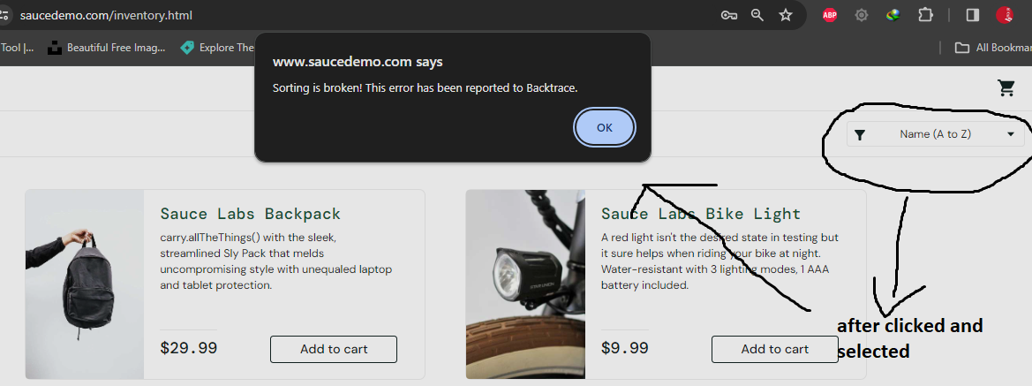
Create DEFECT REPORTING
BugS report
HOMEPAGE – EVIDANCE: Getting Notification Error after clicked componen button: Name (A to Z)

Slide 10
Create DEFECT REPORTING
BugS report
HOMEPAGE: Acceptance Testing
Defect ID | Defect Title | User Story | Defect Description | Priority | Saverity | Pre-Condition | Replication Step | Expected Result | Actual Result
DF-05 | HP-009 | 1. Missing one image of products 2. Distortion icons | CSD-7 As a buyer, I want to be able to open the homepage and see the list of offered products | VISUAL_USER: Displays the homepage with the inappropriate first product image and distortion position of the icons | High | Low | - Users are in the login page - User create login page with 3 components: Username text field, Password text field, and login text field - Create homepage showcasing all the offered products - Display all products with poor UI | 1. User open Web application chrome 2. type the link https://www.saucedemo.com/ 3. Enter the username 4. Enter the Password 5. Click The button Login 6. User in the homepage | Successfully displays all of the image products in the homepage | 1. Displays one product image missing 2. Distortion position of the icons

Slide 11
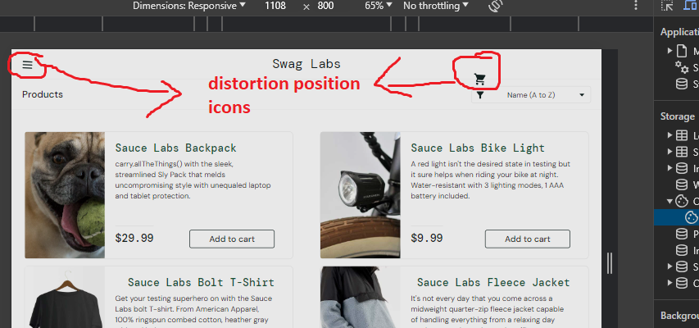
Create DEFECT REPORTING
BugS report
HOMEPAGE – EVIDANCE: 1. Missing one image of products 2. Distortion icons

Slide 12
Create DEFECT REPORTING
BugS report
SHOPPING CART: System Test
Defect ID | Defect Title | User Story | Defect Description | Priority | Saverity | Pre-Condition | Replication Step | Expected Result | Actual Result
DF-06 | SC-012 | 1. Only 3 products can be adding 2. Disabled remove button | CSD-9 As a buyer I want to be able to add a product to my shopping cart | PROBLEM_USER & ERROR_USER 1. Click Button "Add to Cart" only three product items can be added to the shopping cart 2. Cannot clicking the "Remove" button in the homepage | High | Major | - Users in the login page - Users have a valid username and password - Users in the homepage with all offered products - Users Selected many items products - Users have access to click the "Add to cart" of the all product | 1. Users simulate mobile network type with the signal 3G 2. Users access Web application 3. type the link https://www.saucedemo.com/ 4. Enter the valid username 5. Enter the valid Password 6. Click The button Login 7. Users click "Add to cart" 8. Users click icon Cart 9. Users displayed shopping cart page | SUCCESSFULLY loaded within 2509ms for a page listing: 1. Display a new page shows all the products added to the shopping cart successfully 2. Remove the products by clicking Remove button in the homepage successfully | PROBLEM_USER & ERROR_USER 1. Only three product items can be added to the shopping cart 2. Cannot clicking the remove button in the homepage

Slide 13
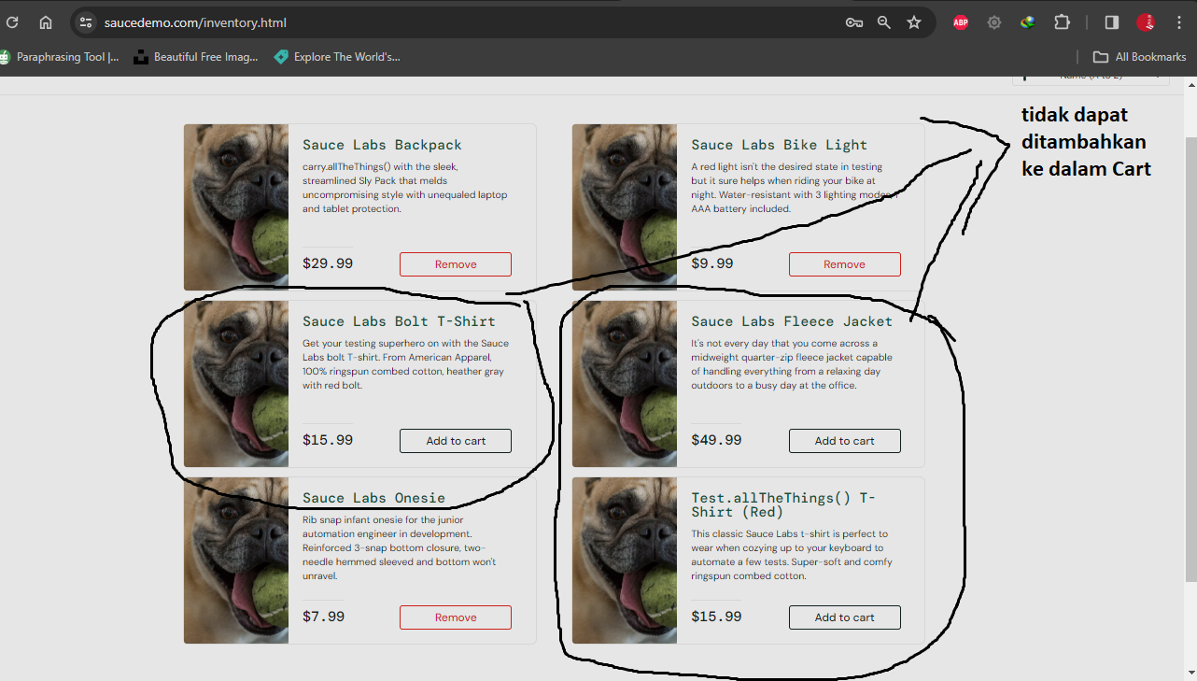
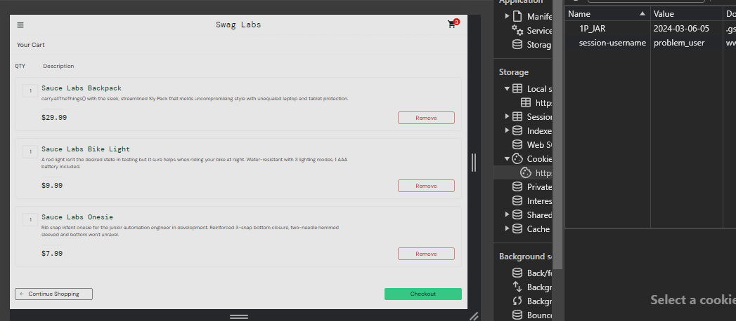
Create DEFECT REPORTING
BugS report
SHOPPING CART – EVIDANCE: Only 3 products can be adding & Disabled remove button

Slide 14
Create DEFECT REPORTING
BugS report
SHOPPING CART
Defect ID | Defect Title | User Story | Defect Description | Priority | Saverity | Pre-Condition | Replication Step | Expected Result | Actual Result
DF-07 | SC-014 | Quantity field and Price field didn't have the result | CSD-10 As a buyer I want to be able to manage the products on my shopping cart | STANDARD_USER, PROBLEM_USER, PERFORMANCE_GLITCH_USER, AND ERROR_USER Into the Shopping Cart page the users cannot interact with the quantity field and Didn't display the result calculated of price | Low | Minor | - Users login as a Buyer - Users have a valid username and password - Users adding items in shopping cart - Users can be able go to a new page with click icon shopping cart - Users has items in shopping cart - Users have access in the Quantity field | 1. Users access Web application 2. type the link https://www.saucedemo.com/ 3. Enter the valid username 4. Enter the valid Password 5. Click The button Login 6. Buyer Click "Add to Cart" all item to adding in shopping cart 7. Buyer click shopping cart icon 8. Buyer locates the Quantity field | 1. Successfylly User can increase or decrease the quantity of each product in the quantity 2. Successfylly that the quantity fields is automatically update | STANDARD_USER, PROBLEM_USER, PERFORMANCE_GLITCH_USER, AND ERROR_USER can't be able interact with the Quantity field and didn't display the result calculated of price

Slide 15
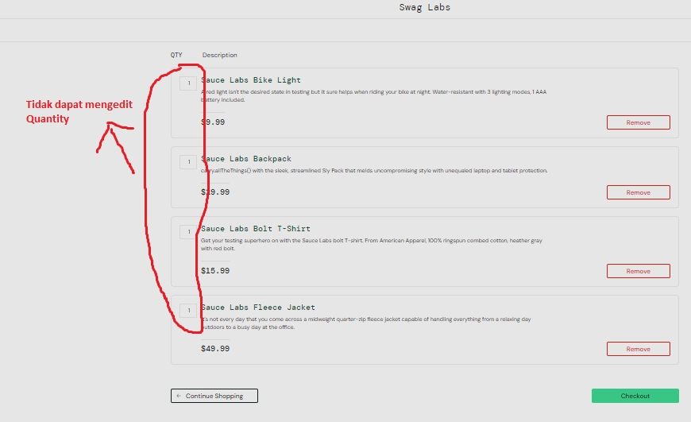
Create DEFECT REPORTING
BugS report
SHOPPING CART – EVIDANCE: Quantity field and Price field didn't have the result

Slide 16
Create DEFECT REPORTING
BugS report
CHECKOUT FEATURE: Performance Test
Defect ID | Defect Title | User Story | Defect Description | Priority | Saverity | Pre-Condition | Replication Step | Expected Result | Actual Result
DF-08 | CF-016 | process successfully when Cart is Empty | CSD-11 As a buyer, I want to be able to perform checkout | standard_user, problem_user, performance_glitch_user, error_user, visual_user Can be able go to the "Checkout: Your Information" page when cart is empty | High | Critical | - Users are in the login page - Users login as a buyer with valid username and password - Users are in the homepage with all the offered products - Users can be able go to a new page with click icon shopping cart - Users has notification "please selected items of the products" - Users has checkout button innactivated in the shopping cart page | '1. User access Web application 2. type the link https://www.saucedemo.com/ 3. Enter the valid username 4. Enter the valid Password 5. Click The button Login 6. User click shopping cart icon 7. User has a messange "Shopping Cart is Empty" 8. Click Checkout Button 9. Filled in all of the text input 10. Click Finish Button | 1. Successfully add a Checkout button disactivated in the shopping cart page 2. Successfully users cannot access the next page 3. SUCCESSFULLY DISPLAY MESSANGE "Cart is Empty" | SUCCESFULLY 1. Add a Checkout button to the shopping cart page 2. Clicking the Checkout button will direct the user to Checkout: Your Information page that has the following fields: a. First name b. Last name c. Zip/Postal Code d. Continue button 3. Successfully processed checkout feature

Slide 17
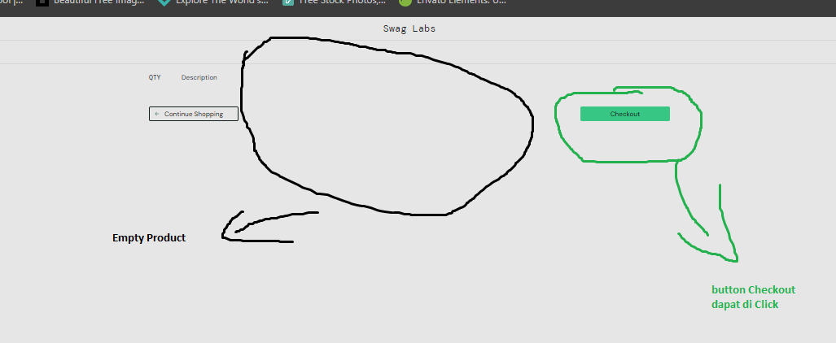
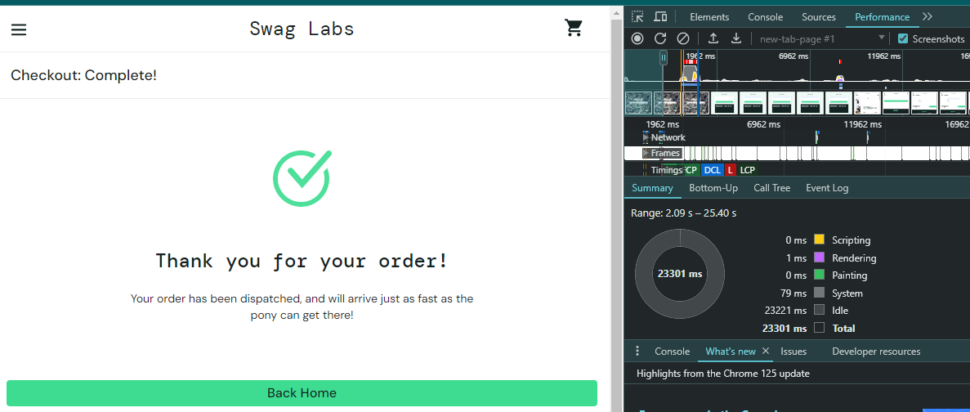
Create DEFECT REPORTING
BugS report
CHECKOUT FEATURE – EVIDANCE: process successfully when Cart is Empty
Hanya membutuhkan waktu > 20s untuk memproses fitur tersebut

Slide 18
Create DEFECT REPORTING
BugS report
CHECKOUT FEATURE
Defect ID | Defect Title | User Story | Defect Description | Priority | Saverity | Pre-Condition | Replication Step | Expected Result | Actual Result
DF-09 | CF-017 | LAST NAME interaction FIRST NAME | CSD-11 As a buyer, I want to be able to perform checkout | problem_user When entered the LAST NAME that would be changing the FIRST NAME | High | Major | - Users are in the login page - Users login as a buyer with valid username and password - Users are in the homepage with all the offered products - User can be able go to a new page with click icon shopping cart - User has clicked checkout button in the shopping cart page - User redirect to Checkoout: Your Information page - User fills in the text field in the Checkout: Your Information page | 1. User access Web application 2. type the link https://www.saucedemo.com/ 3. Enter the valid username 4. Enter the valid Password 5. Click The button Login 6. User adds items product to the shopping cart 7. User click shopping cart icon 8. User click checkout button 9. User fills in the "Checkout: Your Information" page a. First Name b. Last Name c. Zip/Postal Code 10. User click Continue Button | 1. Successfully user is redirected to Checkout: Your Information Page 2. The Field can be to filled a. First Name b. Last Name c. Zip/Postal Code 3. Continue Button disactivated successfully when text fill is empty | 1. Successfully user is redirected to Checkout: Your Information Page 2. The Last Name has an interaction bug 3. Continue Button successfully activated

Slide 19
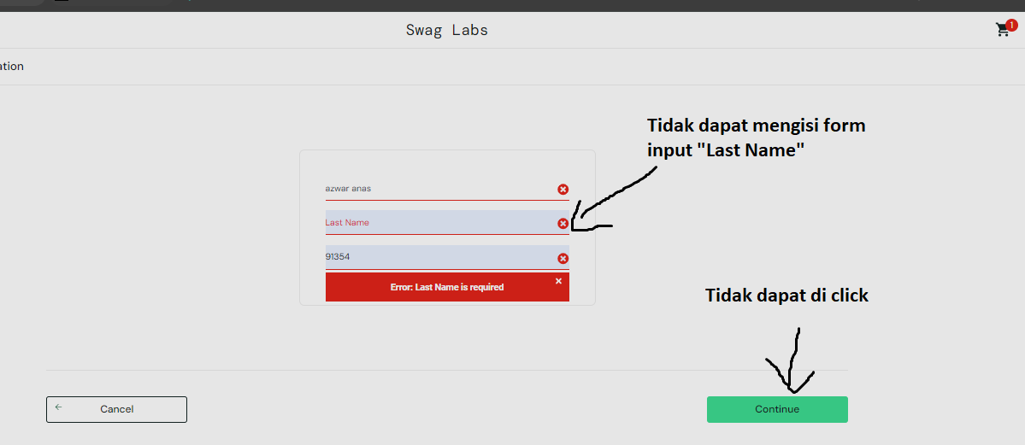
Create DEFECT REPORTING
BugS report
CHECKOUT FEATURE – EVIDANCE: LAST NAME interaction FIRST NAME

Slide 20
Create DEFECT REPORTING
BugS report
CHECKOUT FEATURE
Defect ID | Defect Title | User Story | Defect Description | Priority | Saverity | Pre-Condition | Replication Step | Expected Result | Actual Result
DF-10 | CF-018 | LAST NAME EMPTY cannot be processed | CSD-12 As a buyer, I want to make sure that my purchase details is correct upon checkout | error_user This user didn't have a LAST NAME but cannot be processed | Low | Major | - Users are in the login page - Users login as a buyer with valid username and password - Users are in the homepage with all the offered products - User can be able go to a new page with click icon shopping cart - User has clicked checkout button in the shopping cart page - User redirect to Checkoout: Your Information page - User fills in the text field | 1. User access Web application 2. type the link https://www.saucedemo.com/ 3. Enter the valid username 4. Enter the valid Password 5. Click The button Login 6. User adds items product to the shopping cart 7. User click shopping cart icon 8. User click checkout button 9. User fills in the "Checkout: Your Information" page a. First Name b. Last Name c. Zip/Postal Code 10. User click Continue Button | 1. Successfully user is redirected to Checkout: Your Information Page 2. Successfully the field can be to filled a. First Name c. Zip/Postal Code 3. Successfully User can be able go to Checkout: Overview page by clicking continue button 4. User can be able click Finish button successfully | 1. Successfully user is redirected to Checkout: Your Information Page 2. Successfully the field can be to filled a. First Name c. Zip/Postal Code 3. Successfully User can be able go to Checkout: Overview page by clicking continue button 4. User cannot proceed by clicking the Finish Button

Slide 21
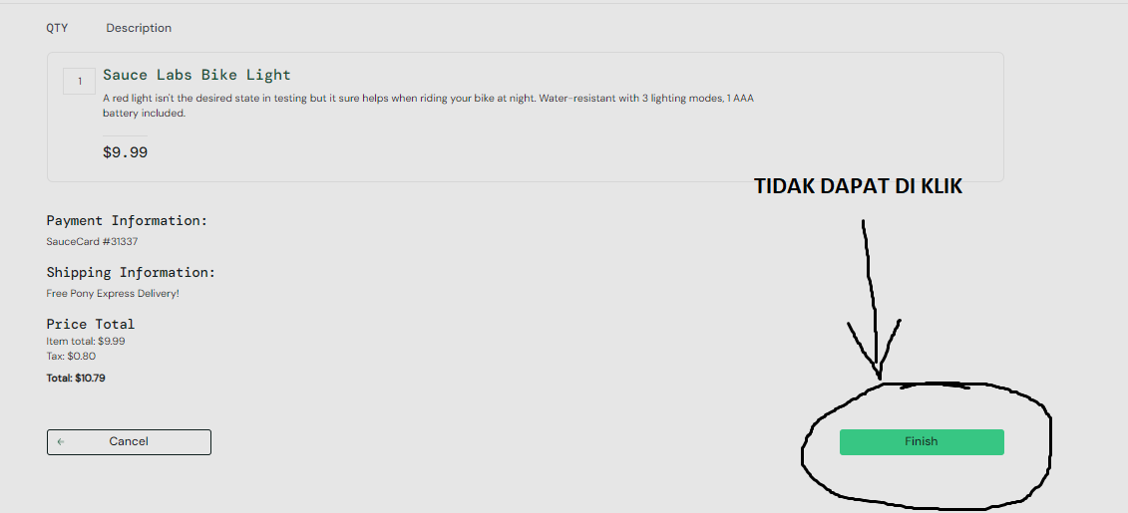
Create DEFECT REPORTING
BugS report
CHECKOUT FEATURE – EVIDANCE: LAST NAME EMPTY cannot be processed

Slide 22
Create DEFECT REPORTING
BugS report
CHECKOUT FEATURE: Regression Testing
Defect ID | Defect Title | User Story | Defect Description | Priority | Saverity | Pre-Condition | Replication Step | Expected Result | Actual Result
DF-11 | CF-020 | Didn't have a popup NOTIFICATION to ensure data user | CSD-12 As a buyer, I want to make sure that my purchase details is correct upon checkout | standard_user, performance_glitch_user, visual_user Recall all the detail entered by the user, Make sure your data has been entered is correct when you want to finish the process | Medium | Minor | - Users are in the login page - Users login as a buyer with valid username and password - Users are in the homepage with all the offered products - Users can be able go to a new page with click icon shopping cart - Users has clicked checkout button in the shopping cart page - Users redirect to Checkoout: Your Information page - Users fills in the text field - Users will finalise the checkout proccess - Users will see Notification proccess - Users access button in the Notification Process | 1. User access Web application 2. type the link https://www.saucedemo.com/ 3. Enter the valid username 4. Enter the valid Password 5. Click The button Login 6. User adds items product to the shopping cart 7. User click shopping cart icon 8. User click checkout button 9. User fill in the following "Checkout: Your Information" a. First Name b. Last Name c. Zip/Postal Code 10. User click Continue Button 11. aplication displays the purchase details overview page 12. User click Finish Button 13. application displays a notification "Yes or No" to confirm that the purchase information is correct 14. User selects 'No' and return to the Cart Page 15. User select 'Yes' to finish checkout process | 1. Application successfully displays a notification "Make sure your data has been entered is correct" ' 2. Successfully access button "Yes or No" to confirm the purchase. 3. Successfully clicked button 'Yes', to proccess completed. 4. Successfullu clicked 'No', the user is returned to the CART page. | 1. Completed the proccess without display Notification

Slide 23
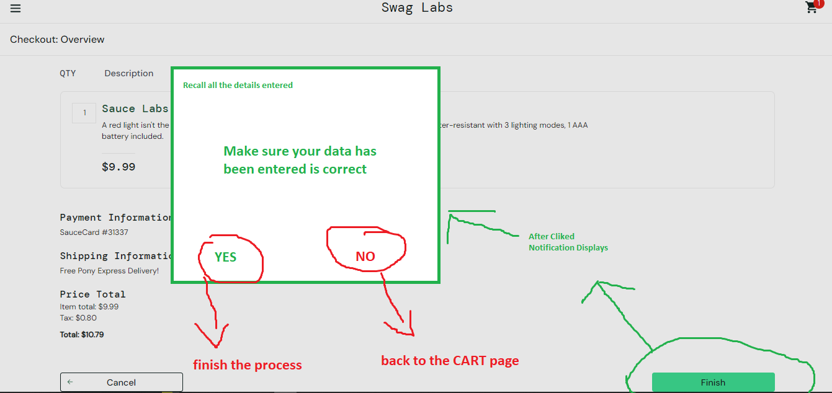
Create DEFECT REPORTING
BugS report
CHECKOUT FEATURE – Didn't have a popup NOTIFICATION to ensure data user

Slide 24
FINAL PROJECT 2
- Blazedemo (PAB) -
- Muhammad Azwar Anas -

Slide 25
Create test Execution log
Test execution summary
Test/Suite Name | User Story | Pending |  | Executed |  | Total Test Case
 |  | In Progress | Not Validated | Tests Passed | Tests Failed
Login | As a user, I want to be able to login on the application demoblaze | In Progress | - | 3 | 1 | 4
Homepage | As a user, I want to be able to view Homepage | In Progress | - | 1 | 0 | 1
Homepage | As a user, I want to be able to view product baseon category | In Progress | - | 1 | 0 | 1
Homepage | As a user, I want to be able to view next page and previous page | In Progress | - | 2 | 0 | 2
Homepage | As a user, I want to be able to view a carousel containing featured products on the homepage | In Progress | - | 2 | 0 | 2
Homepage | As a user, I want to be able to search the product | In Progress | - | 0 | 1 | 1
Sign up | As a user, I want to be able to register demoablaze application | In Progress | - | 3 | 1 | 4
Cart | As a user, I want to be able to delete product from Cart page | In Progress | - | 2 | 0 | 2
Cart | As a user, I want to be able to purchase product from Cart page | In Progress | - | 2 | 2 | 4
Cart | As a user, I want to be able to add quantity product | In Progress | - | 0 | 1 | 1
Product | As a user, I want to be able to view detail product | In Progress | - | 1 | 1 | 2
Product | As a user, I want to be able to add product to cart | In Progress | - | 1 | 0 | 1

Slide 26
Create DEFECT REPORTING
BugS report
LOGIN – System Testing
Defect ID | Defect Summary | Defect Description | Step to Reproduce | Expected Result | Actual Result | Environment | Severity | Priority
DF-01 | LO-004 | 1. Input wrong password three times 2. User Account Blocked | User has been blocked when click login button after input Incorrect password 3 times instead displaying wrong password. The system should be have an action on this bug | 1.User is already open the web browser 2. User visiting url demoblaze,com 3. User Click Login in navbar menu 4.User already on the login page 5. User Input Username 6. User Input incorrect password 3 times 7. User Click button login | 1. System correctly block the username successfully 2. Display messange "Username Account is Blocked" successfully | System Displays a popup messange saying "Wrong Password" | Web Browser Edge, windows 10 | Major | High

Slide 27
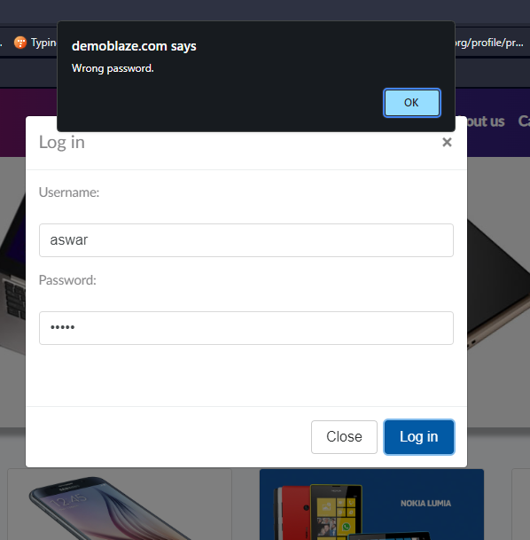
Create DEFECT REPORTING
BugS report
EVIDANCE: Input wrong password three times & User Account Blocked

Slide 28
Create DEFECT REPORTING
BugS report
HOME PAGE: Componen Integration Testing
Defect ID | Defect Summary | Defect Description | Step to Reproduce | Expected Result | Actual Result | Environment | Severity | Priority
DF-02 | HP-011 | Search input didn't exist in the homepage | User is already on the Homepage and shoul be able to prform the actions below: 1. Searching products with valid name 2. Searching products with valid character | 1. User hit address http://www.demoblaze.com on the web browser 2. User hit enter on keyboard 3. application displays "Search Input" in navbar menu 4. User type the name of the product in the text field Search Input 5. application displays the product base on the text field 6. User click button search or enter the keyboard | Successfully displays the product base on the data or text field | application / system didn't have search feature | Web Browser Edge, windows 10 | Low | High

Slide 29
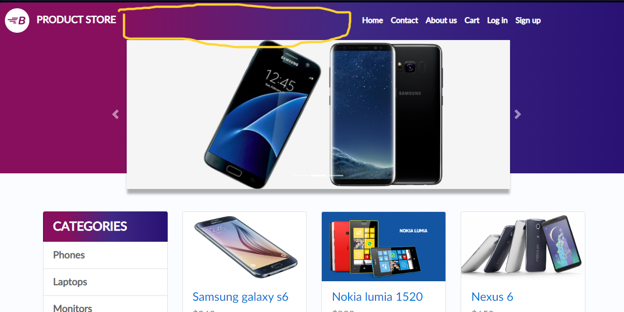
Create DEFECT REPORTING
BugS report
EVIDANCE: Searching products with valid name & Searching products with valid character

Slide 30
Create DEFECT REPORTING
BugS report
SIGN UP –Performance Testing
Defect ID | Defect Summary | Defect Description | Step to Reproduce | Expected Result | Actual Result | Environment | Severity | Priority
DF-03 | SU-013 | Register with valid special character | User can be able using special character as username. Must be have an action on this proccess to make username Username must be memorable, Unique, and readable | 1. User hit address http://www.demoblaze.com on the web browser 2. User click "Sign up" on the navbar menu 3. User input "Special Character" in the username text field 4. User move to the next password text field 5. Display notification "undifined character" | Successfully display notification error "Undifined Character" | Succesfully entered the "Special Character" | Web Browser Opera One(version: 109.0.5097.38), windows 10 | Critycal | High

Slide 31
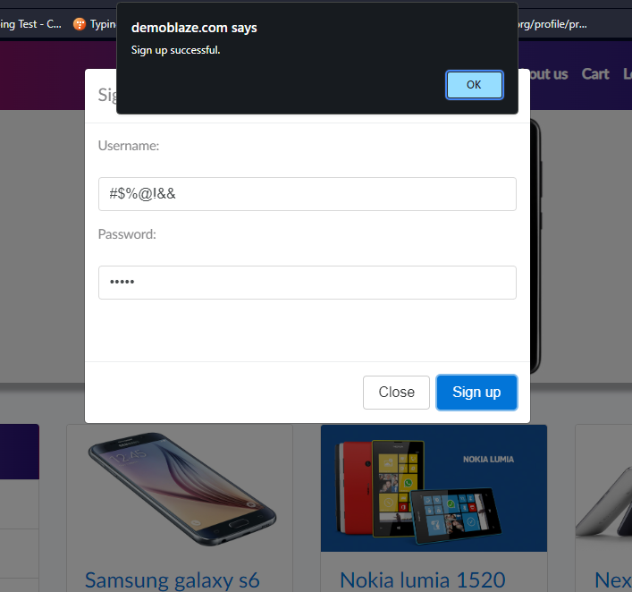
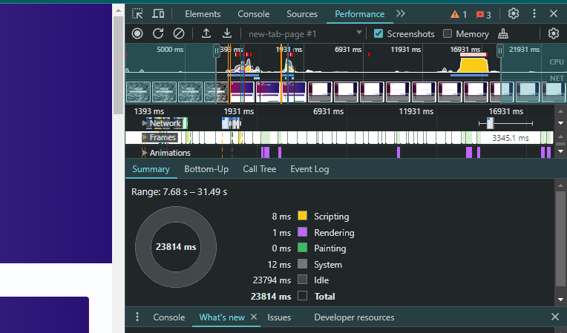
Create DEFECT REPORTING
BugS report
SIGN UP: Register with valid Username contain special character
Hanya membutuhkan waktu > 20s untuk memproses fitur tersebut

Slide 32
Create DEFECT REPORTING
BugS report
CART PAGE: System Integration Testing
Defect ID | Defect Summary | Defect Description | Step to Reproduce | Expected Result | Actual Result | Environment | Severity | Priority
DF-04 | CR-019 | Empty Text Field Country | User purchases successfully, but left the country field blank. Users are free to fill in the country text field or leave it blank, but there may be users from various countries making purchases. | 1. User hit address http://www.demoblaze.com 2. User Click thubnails or image of the Products 3. User add product 4. User Click Cart in navbar menu 5. Uer click Place Order button 6. Input all text field into the Place Order Modal, excerpt for the Country text field. 7. Click button Purchase | Successfully displays popup warning Text fill Country | Unsuccesfully display a popup warning | Web Browser Edge, windows 10 | Minor | Low

Slide 33
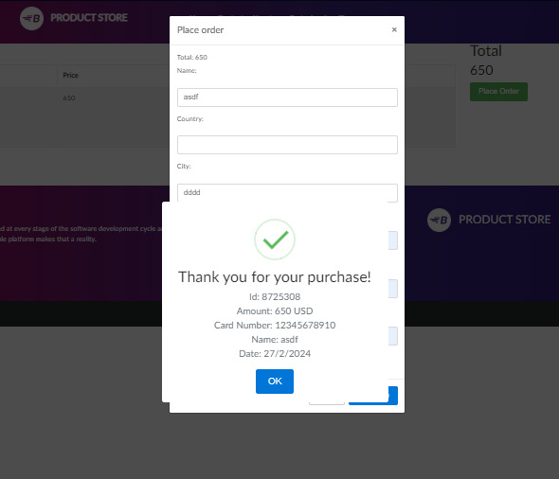
Create DEFECT REPORTING
BugS report
CART PAGE: Mandatory Text Field Country

Slide 34
Create DEFECT REPORTING
BugS report
CART PAGE: Regression Testing
Defect ID | Defect Summary | Defect Description | Step to Reproduce | Expected Result | Actual Result | Environment | Severity | Priority
DF-04 | CR-021 | make a purchase before logging in | User should register and log in to the application if they want to make a purchase | 1. User hit address http://www.demoblaze.com 2. User Click thubnails or image of the Products 3. User add product 4. User Click Cart in navbar menu 5. Uer click Place Order button 6. Input all text field into the Place Order Modal 7. Click button Purchase | Successfully display a notification : "Please log in first to proceed with the purchase | Successfully purchasing with notification "Thank you for your purchase!" | Web Browser Edge, windows 10 | Critycal | High

Slide 35
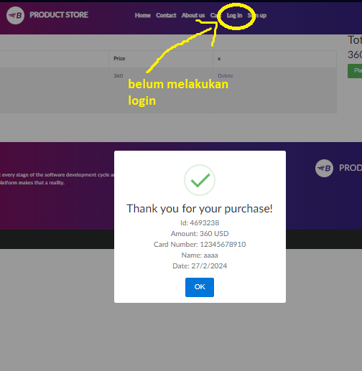
Create DEFECT REPORTING
BugS report
CART PAGE: make a purchase before logging in

Slide 36
Create DEFECT REPORTING
BugS report
CART PAGE: Componen Testing
Defect ID | Defect Summary | Defect Description | Step to Reproduce | Expected Result | Actual Result | Environment | Severity | Priority
DF-05 | CR-022 | Cart page invalid displays increase (+) and decrease (-) | The Application or system should display components for addition (+) and subtraction (-), as well as the total price of all prodcuts. Users are allowed to add or remove the quantity of product | 1. User hit address http://www.demoblaze.com 2. User Click thubnails or image of the Products 3. User add product 4. User Click Cart in navbar menu 5. User click (+) for increase or (-) for decrease the quantity of products | Successfully Increase (+) or Decrease (-) the quantity of the selected product | The Quantity of the product is NOT displayed | Web Browser Edge, windows 10 | Low | High

Slide 37
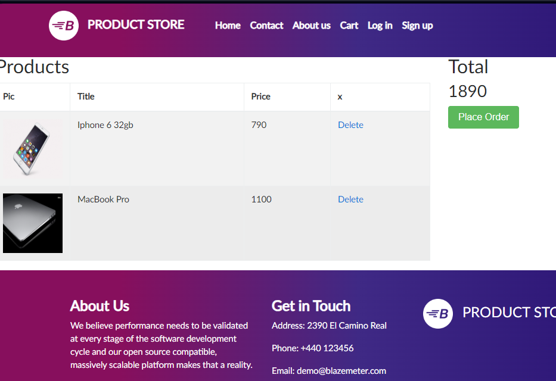
Create DEFECT REPORTING
BugS report
EVIDANCE: Increase or Decrease quantity of products

Slide 38
Create DEFECT REPORTING
BugS report
PRODUCT DETAIL PAGE: Compatibility Testing
Defect ID | Defect Summary | Defect Description | Step to Reproduce | Expected Result | Actual Result | Environment | Severity | Priority
DF-06 | PR-024 | Product detail page not displaying wishlist button and proper UI | Testing was conducted using mobile dimensions on the detail page of the added product, ensuring a good UI that fits the applied dimensions. Additionally, the wishlis button is not displayed on the detail page. | User simulate in mobile device or max screen (320 X 480) User open web browser application User entering the address in the adress-bar User hit address http://www.demoblaze.com User hit enter on keyboard User click thumbnail or title one of the products | 1. Displaying proper UI successfully 2. Successfully displaying button add to wishlist 3. Successfully click button add to wishlist | Unsuccessfully displaying button add to wishlist UI not proper | Web Browser Edge, windows 10 | Low | Medium

Slide 39
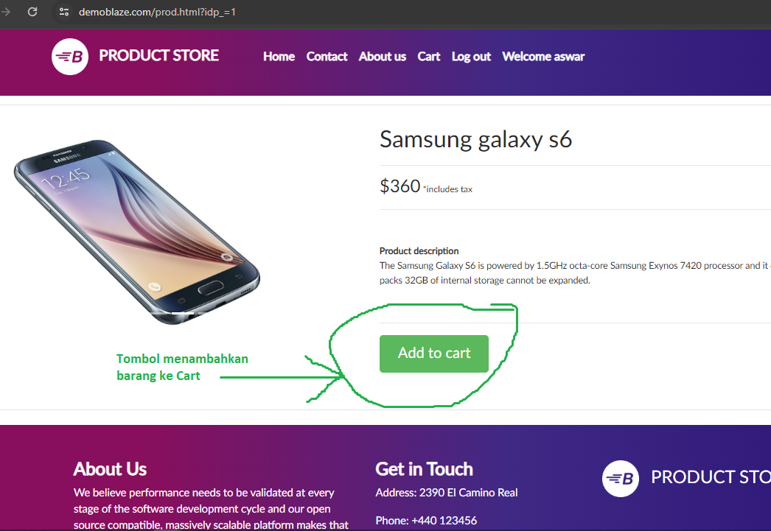
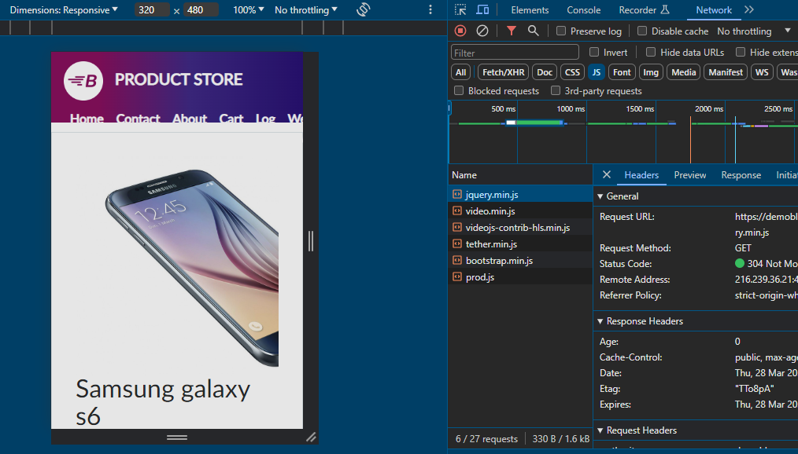
Create DEFECT REPORTING
BugS report
EVIDANCE: Product detail page with wishlist button
Halaman Detai Produk pada dimensi Mobile max(320px X 480px)

Slide 40
FINAL PROJECT 3 SQL TEST
- https://www.programiz.com/sql/online-compiler/ -
- Muhammad Azwar Anas -

Slide 41
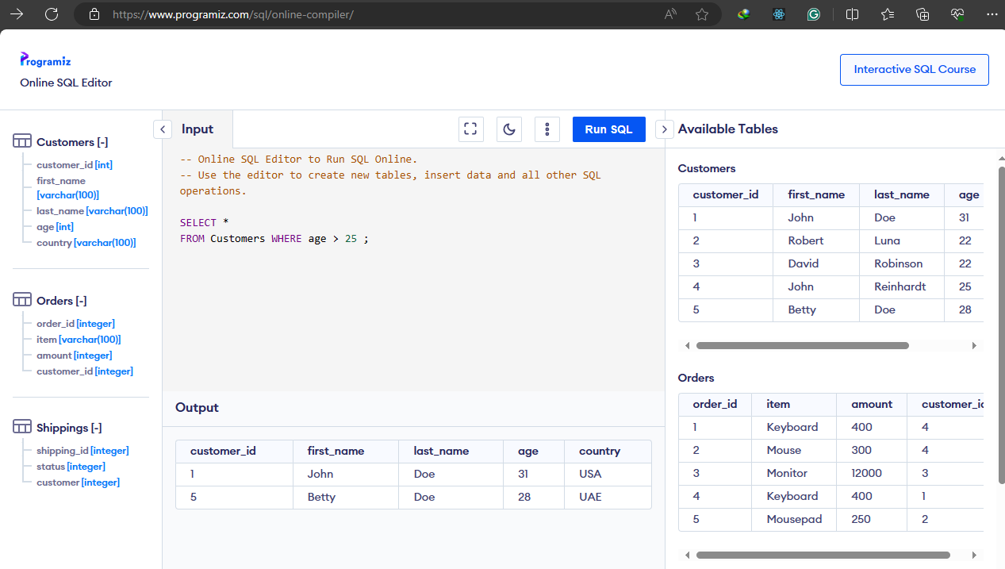
Sql test
All customers 24 > years old
Menampilkan data Customers Dimana data umur yang diatas dari 25 (age > 25)

Slide 42
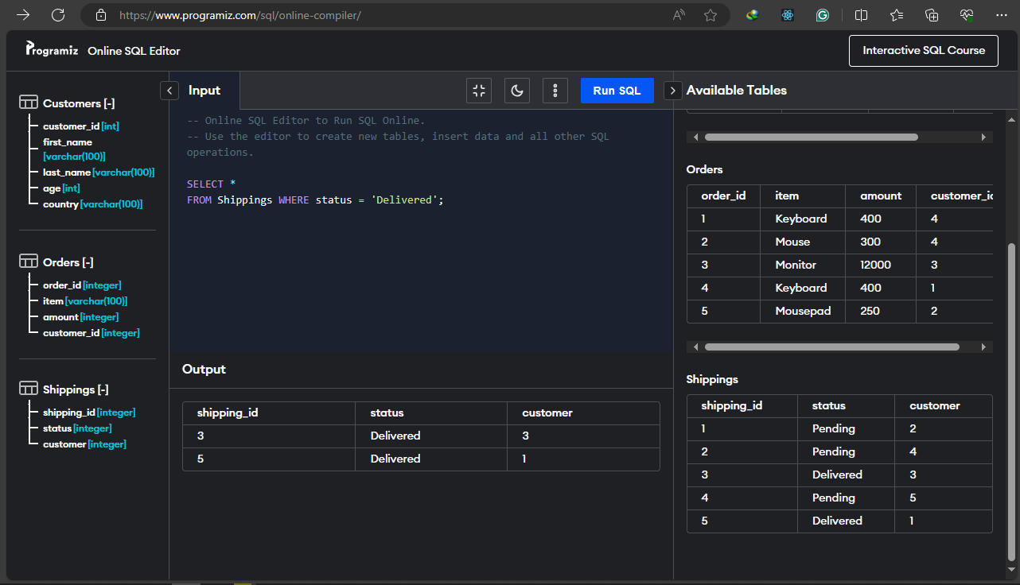
Sql test
All delivered status
Menampilkan data table Shippings Dimana status datanya adalah ‘Delivered’

Slide 43
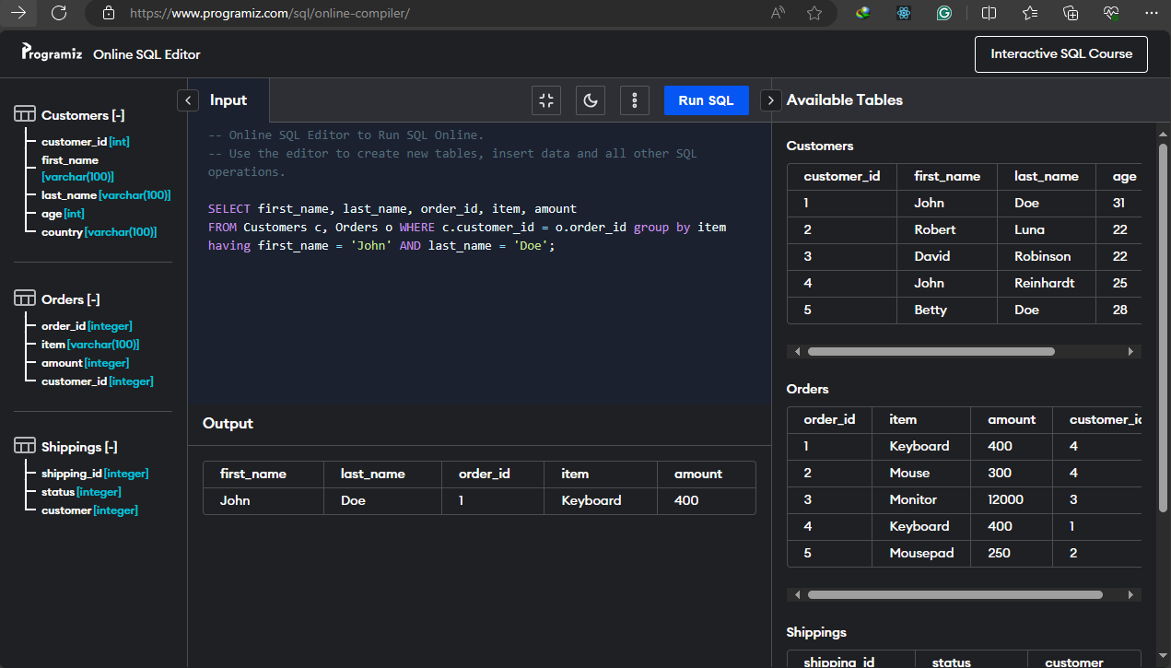
Sql test
Record from the orders jon doe
Menampilkan catatan pemesanan yang dilakukan oleh Jon Doe

Slide 44
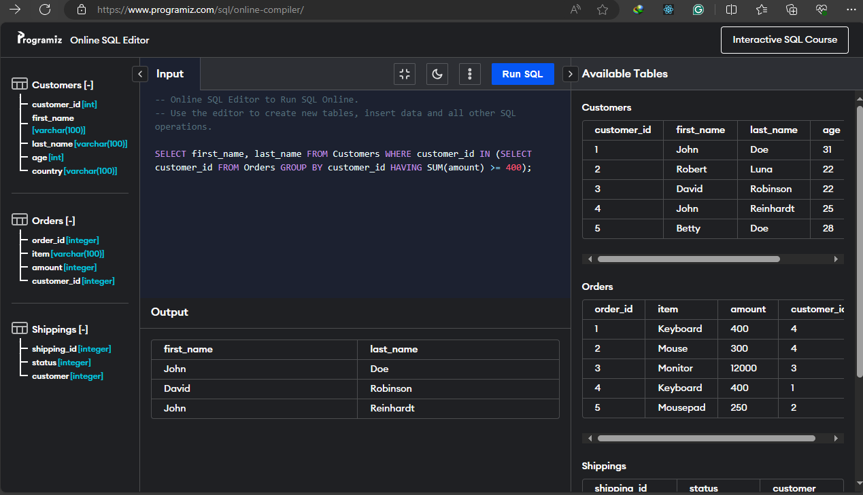
Sql test
Customers first name and last name who more than or equal 400
Menampilkan first_name dan last_name dari data Customers dengan nilai yang lebih atau sama dengan 400

Slide 45
TERIMAKASIH
- Muhammad Azwar Anas -

